Slide 1

Made by Vaibhav Chaudhary

Slide 2
What is Git?
Git is a distributed version control system, which is free and open source. Created by Linus Torvalds, the developer of Linux operating system kernel, in 2005. Git is used for project collaboration and history exploration.
Version Control System: Version control refers to the practice of tracking and managing changes to software code, and Version Control Systems refers to software tools that assist software teams in managing changes to source code over time.
Distributed VCS: Every participating node in distributed VCS has a complete copy of the project as well as a full revision history of each file. This allows you to work locally without a network connection all while allowing you to collaborate when you are back online via central remote repositories.
Notes:
Basically, it is a software which stores the snapshots of the versions of your code and lets you come back to any version at just a click.
Version Control System means that if you accidentally delete a file or make a mistake, you have nothing to worry about, you can just recover them.
VCS can not only restore your previous working version, but it can also solve other concerns with code management and application deployment.

Slide 3
Why do we use it?🤔
Trace the changes made to the code
Simplify code review
Modify code efficiently
Maintaining multiple versions of the code
Better collaboration and improved productivity
Lightweight and fast
Notes:
Traces changes and lets you revert back to any previous versions of the file, or whole project, monitor changes, who updated what in which version and why…
Find errors by checking what updations were made in what versions
Imagine having a time stone to go back and rectify your mistakes, create a new tangent in the time axis and manage messed up things, it just is the tool
Requirements always change, new features added or older ones removed can be done in different branches and merged later if everything goes well
You can work with your team on the same project in different branches and merge the things later on. This decreases interdependence in team, thereby increasing the productivity
Almost everything in git is done locally on computer and then can be uploaded to GitHub at the end of the day. Further the source code of git is in C, which is anyways fast.

Slide 4
How it works?
Three main areas where code lives:-
Working tree: It contains the files we are currently working on.
Staging area: It contains all the added files having new/changed code.All new/changed files are first added to the staging area before commit.
Repository: It contains all the files of the project.
Every file goes through 3 stages:
Modified: File is modified/changed in this stage.
Staged: Modified files sent into staging area.
Committed: Files are committed to reflect the changes and store in the database.
Notes:
Repository can be local or on some hosting service as GitHub or bit bucket, etc.
Can be pushed to remote repository as well after committing.

Slide 5
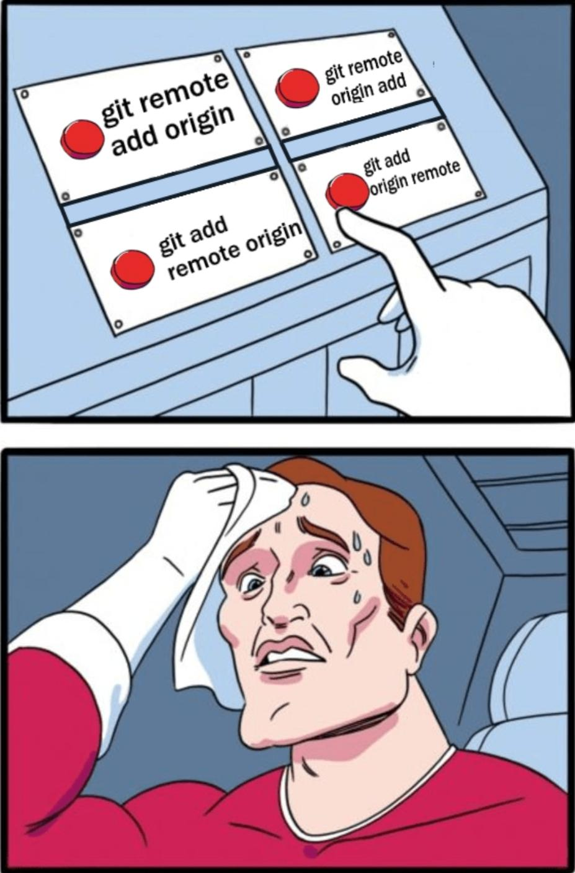
Newer Git concepts…

